Slide 1
CIS117 Week 3
Common commands and path

Slide 2
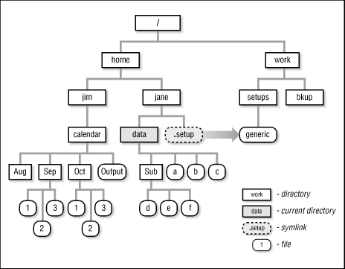
Absolute vs relative path
Absolute path
Starts at root
Relative path
Working directory
pwd
ls
https://docstore.mik.ua/orelly/unix/upt/ch14_02.htm

Slide 3
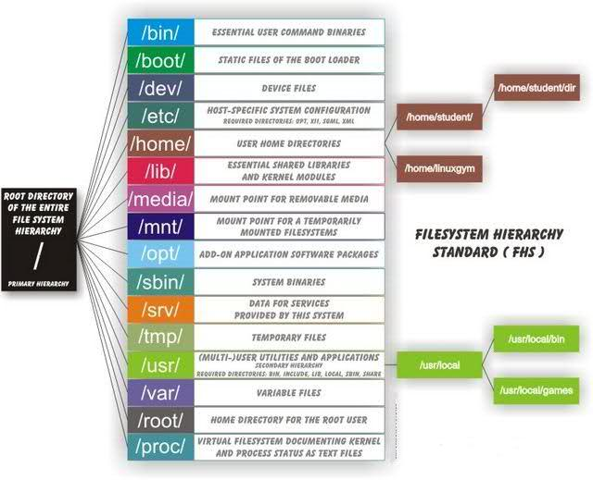
Map your system
Working directory
mkdir vs cd
https://www.tecmint.com/linux-directory-structure-and-important-files-paths-explained/

Slide 4
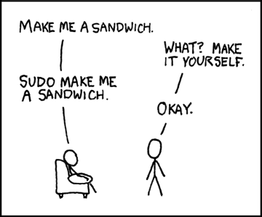
Good to know symbols
. (Current or working directory)
.. (parent directory, or one up)
/ (directory or folder)
* (wildcard)
https://xkcd.com/149/

Slide 5
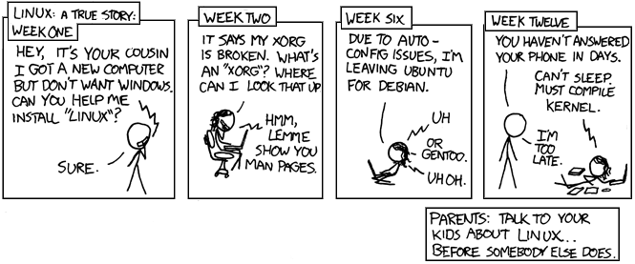
Demo
ls
cd
touch
mkdir
cp
mv
https://xkcd.com/456/

